Slide 1

Data Warehousing
Software Architectures and Database Systems
By Maciej Penar ©
mpenar@kia.prz.edu.pl

Slide 2
Sample Database To test things
Sample databases:
AdventureWorks (SQL Server)
Northwind (SQL Server)
AdventureWorks DW (SQL Server)
HR (Oracle)
SAMPLE (DB2)
TPC-H/TPC-C/TPC-E
We will use AdventureWorks

Slide 3
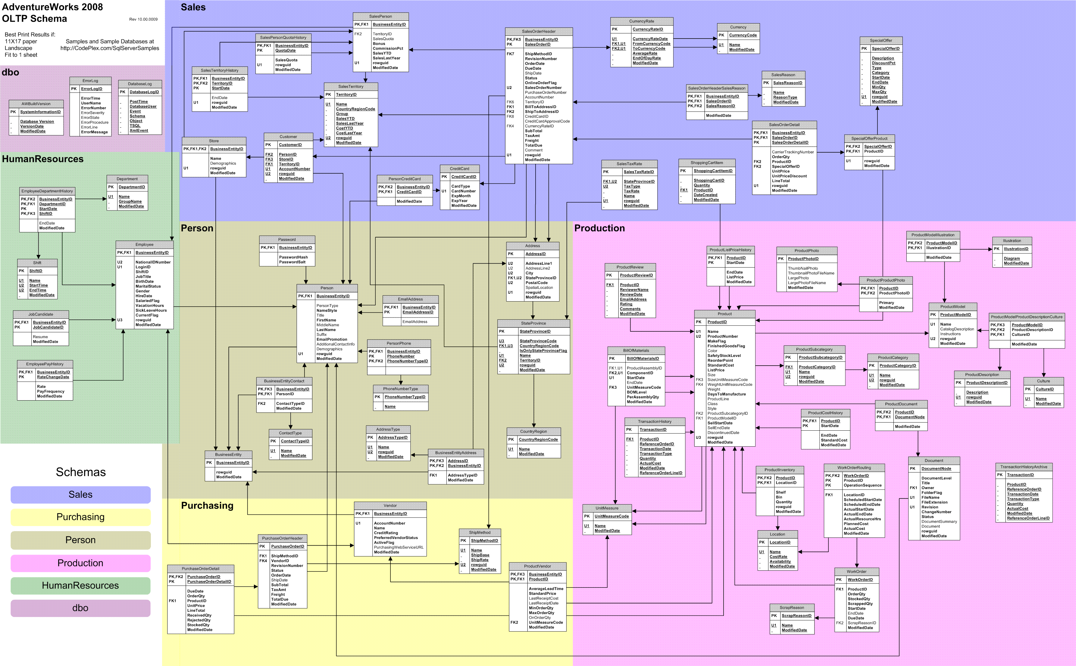
Schema

Slide 4
Theoretics

Slide 5
Data Warehouses Theoretics
Why we create DW solutions:
Because we believe in the performance gain
Because we have Single-Version-Of-Truth
Because we have centraliezed perspective
Mainy we want to describe:
Events
Processes
In a way that is understandable to business users

Slide 6
Data Warehouses Theoretics
Some notes:
Data Warehousing is a proces
Sometimes when people think Data Warehouse they actually mean Data Mart which is a specialized kind of database
Building DW is a fairly dangerous process – it is estimated that 30% of DW are a success (can’t give any source on that, but from my Exp it is a fairly reasonable number)
You can easily fail the DW if end-user have prior assumptions. If the data is collected just for the sake of collecting the data, the DW quickly become Data Silo.

Slide 7
Data Warehouses Theoretics
If you want to build the successfull DW:
You have to find a „moron” in company who knows what DWs are build for… and is ready to defend the concept of building the DW in front of CEO/CTO/board

Slide 8
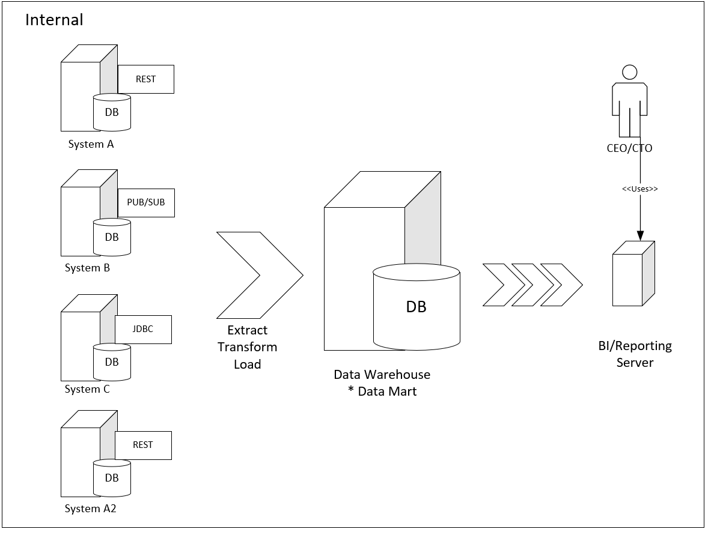
Data Warehouses Theoretics
Model 1:
Probably Process-centric
Probably direct access to DBs

Slide 9
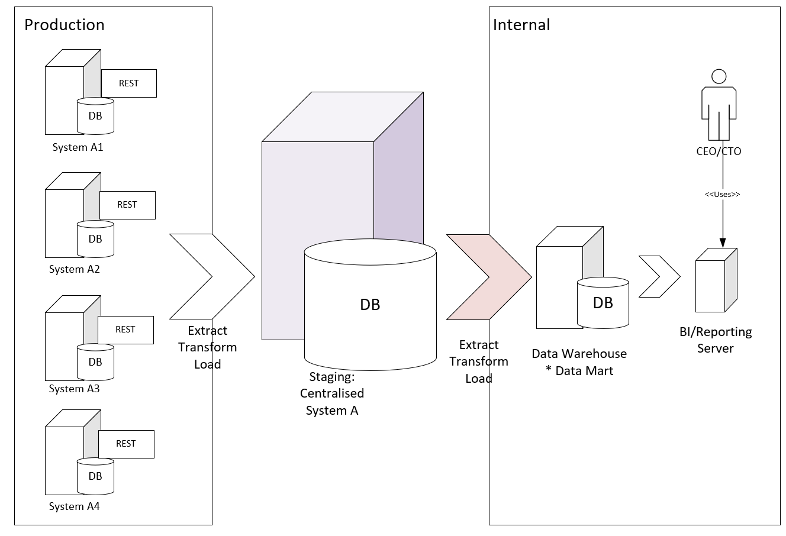
Data Warehouses Theoretics
Model 2:
Probably Event-based
Probably indirect access to DBs
Staging is required (as insurance)

Slide 10
Data Warehouses Theoretics
There are three logical models/approaches to building up the DWs:
DW in 3NF – preached by Inmon – so called snowflake schema
Multidimensional model – preached by Kimball – so called star schema
Data Vault – preached by Linstead – called… well… Data Vault
All three approaches leads to more-or-less the same result…
If anyone is stating the supremacy of one-over-another he’s basically stating that:
Vi > Emacs

Slide 11
Data Warehouses Theoretics
Both Inmon/Kimball approaches defines some common terms:
Fact – which is a point of our interest/analysis. Fact can be perceived as event at some level or an instance of a process. Fact is described using dimensions and measures
Dimension – is a descriptor of the Fact
Measures – describe the extent of the Fact. In most cases the measures can be aggregated somehow along dimensions – they are numeric

Slide 12
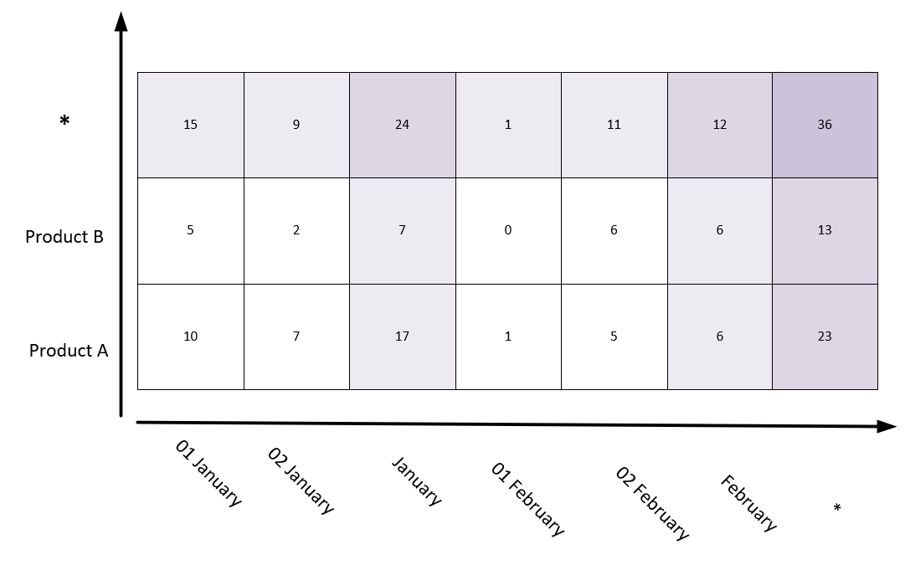
Data Warehouses Theoretics
O(1)

Slide 13
ETLs

Slide 14
ETLs Utilities Justice
In order to perform the test in „laboratory” conditions, we have to clear the cache and buffer pool (so no data reside in main-memory). To do so in SQL Server we use:
DBCC DROPCLEANBUFFERS
DBCC FREEPROCCACHE
Also we enable IO statistics:
SET STATISTICS IO ON

Slide 15
ETLs Utilities SELECT INTO
Surprisingly common statement used to persist the output of the SELECT statement. It is a first-order warrior in DW battle:
SELECT …
INTO X
FROM …

Slide 16
ETLs Utilities WITH CUBE
Deprecated statement used to perform brute-force groupping. It basically calculates all combinations of groupings – as GROUP BY list suggest. Historically used in conjunction with SELECT INTO
GROUP BY x, z
UNION
GROUP BY null, z
UNION
GROUP BY x, null
UNION
GROUP BY null, null
GROUP BY
x,
z WITH CUBE;

Slide 17
ETLs Utilities WITH ROLLUP
Deprecated statement. Remix of WITH CUBE. It calculates groups, folding in reverse order as GROUP BY list suggests.
GROUP BY x, z
UNION
GROUP BY x, null
UNION
GROUP BY null, null
GROUP BY
x,
z WITH ROLLUP;

Slide 18
ETLs Utilities GROUPING SETS
New statement which is used for a fine-grained control over GROUP BY groupings. Due to its fine-grained control – it is preffered solution over the WITH CUBE / WITH ROLLUP
GROUP BY x, y, z
UNION
GROUP BY x, null, null
UNION
GROUP BY null, null
GROUP BY
GROUPING SETS(
(x,y,z),
(x),
()
);

Slide 19
ETLs Utilities SQL
WITH Temp AS (
SELECT
POH.OrderDate,
P.Name,
SUM(POD.OrderQty)AS QUANTITY,
MAX(POD.UnitPrice)AS UNIT_PRICE,
SUM(POD.UnitPrice*POD.OrderQty) AS TOTAL
FROM
[Purchasing].[PurchaseOrderDetail]POD
INNER JOIN [Purchasing].[PurchaseOrderHeader]POHON POD.PurchaseOrderID = POH.PurchaseOrderID
INNER JOIN [Production].[Product]PON P.ProductID = POD.ProductID
WHERE
POH.OrderDate BETWEEN '2011-01-01 00:00:00.000' AND '2012-01-01 00:00:00.000'
AND P.Name = 'Flat Washer 1'
GROUP BY
P.Name,
POH.OrderDate)
SELECT * FROM Temp;

Slide 20
ETLs Utilities MERGE
MERGE INTO UsersDW AS Target
USING Users AS Source
ON Target.PESEL = Source.PESEL AND Target.Active = 1
WHEN MATCHED THEN
UPDATE SET Age = Source.Age, Name = Source.Name, Active = CASE WHEN Source.Sex = Target.Sex AND Source.Surname = Target.Surname THEN 1 ELSE 0 END, DateTo = CASE WHEN Source.Sex = Target.Sex AND Source.Surname = Target.Surname THEN Target.DateTo ELSE @dupa END
--INSERT INTO UsersDW(PESEL, Age, Surname, Name, Sex, Active) VALUES(Source.PESEL, Source.Age, Source.Surname, Source.Name, Source.Sex, 1)
WHEN NOT MATCHED THEN
INSERT (PESEL, Age, Surname, Name, Sex, Active, DateFrom, DateTo) VALUES(Source.PESEL, Source.Age, Source.Surname, Source.Name, Source.Sex, 1, @date, NULL);

Slide 21
ETLs Utilities Traditional SQL
It’s hard to think about SQL in other terms than:
$FROM→WHERE →GROUP BY →HAVING →ORDER BY → SELECT$
$R→ σ → γ_{θ}→ τ → π$

Slide 22
ETLs Utilities Recursive SQL
It’s hard to think about SQL in other terms than:
$FROM→WHERE →GROUP BY →HAVING →ORDER BY → SELECT$
$R→ σ → γ_{θ}→ τ → π$

Slide 23
ETLs Utilities Recursive SQL
CREATE TABLE Graph(
Id INT PRIMARY KEY,
BossId INT NULL REFERENCES Graph(Id),
MyName VARCHAR(100)
):
INSERT INTO Graph VALUES(1, NULL, 'Mr Rektor');
INSERT INTO Graph VALUES(2, 1, 'Mr Kierownik KIA');
INSERT INTO Graph VALUES(4, 2, 'Student 1');
INSERT INTO Graph VALUES(5, 2, 'Student 2');
INSERT INTO Graph VALUES(3, 1, 'Mr Kierownik Zarz');
INSERT INTO Graph VALUES(6, 3, 'Prowadzący 1');
INSERT INTO Graph VALUES(7, 6, 'Student 3');

Slide 24
ETLs Utilities Recursive SQL
SELECT
g1.MyName AS 'Me',
g2.MyName AS 'My Boss',
g3.MyNAme AS 'Boss of My Boss'
FROM
Graph g1
INNER JOIN Graph g2 ON g1.BossId = g2.Id
INNER JOIN Graph g3 ON g2.BossId = g3.Id
WHERE
g1.MyName = 'Student 3'

Slide 25
ETLs Utilities Recursive SQL
SELECT
g1.MyName AS 'Me',
g2.MyName AS 'My Boss'
FROM
Graph g1
INNER JOIN Graph g2 ON g1.BossId = g2.Id
WHERE
g1.MyName = 'Student 3'
UNION ALL
SELECT
g1.MyName AS 'Me',
g3.MyName AS 'My Boss'
FROM
Graph g1
INNER JOIN Graph g2 ON g1.BossId = g2.Id
INNER JOIN Graph g3 ON g2.BossId = g3.Id
WHERE
g1.MyName = 'Student 3'

Slide 26
ETLs Utilities Recursive SQL
WITH Temp(Me, MyBoss, BossBossId) AS(
SELECT
g1.MyName,
g2.MyName,
g2.BossId
FROM Graph g1 INNER JOIN Graph g2 ON g1.BossId = g2.Id
WHERE g1.MyName = ?
UNION ALL
SELECT
g1.Me,
g2.MyName,
g2.BossId
FROM
Temp g1
INNER JOIN Graph g2 ON g1.BossBossId = g2.Id
)
SELECT * FROM Temp;

Slide 27
ETLs Utilities Recursive SQL
WITH R(TEST) AS(
SELECT GETDATE()
UNION ALL
SELECT DATEADD(DAY, 1, TEST) FROM R WHERE TEST < DATEADD(DAY, 100, GETDATE())
)
SELECT * FROM R

Slide 28
ETLs Utilities OLAP Functions
ALTER TABLE [Purchasing].[PurchaseOrderHeader]
ADD OrderDateYear AS YEAR(OrderDate) PERSISTED;
ALTER TABLE [Purchasing].[PurchaseOrderHeader]
ADD OrderDateMonth AS MONTH(OrderDate);
ALTER TABLE [Purchasing].[PurchaseOrderHeader]
ADD OrderDateQuarter AS CEILING(MONTH(OrderDate)/3.0);

Slide 29
ETLs Utilities Easier problem
SELECT
POH.OrderDateYear,
POH.OrderDateMonth,
SUM(CASE WHEN POH.Status IN (3,4) THEN 1 ELSE 0 END) AS '34',
SUM(CASE WHEN POH.Status = 2 THEN 1 ELSE 0 END) AS '2',
COUNT(*) AS C
FROM
[AdventureWorks2016].[Purchasing].[PurchaseOrderHeader] POH
GROUP BY
POH.OrderDateYear,
POH.OrderDateMonth
ORDER BY
POH.OrderDateYear,
POH.OrderDateMonth

Slide 30
ETLs Utilities Harder problem

Slide 31
ETLs Utilities Delete replicants
CREATE TABLE XXXX(
Id INT IDENTITY,
Name VARCHAR(10)
)
WITH R(Id, Name, RN) AS(
SELECT
Id,
Name,
ROW_NUMBER() OVER(PARTITION BY Id ORDER BY Id)
FROM
XXXX
)
DELETE FROM R WHERE RN > 1

Slide 32
That’s all for now

